Slide 1
Mid-Project Review
Elliot Gardner
MSIA-423

Slide 2
Highlights
Completed Data Pipeline for Eventbrite API
Ingesting data roughly every 12 hours since mid-April
Approximately 5% of events sell out prior to the start data in the data so far

Slide 3
Review Progress
Data Gathering: API Integration completed
Data Gathering: Data Capture completed
Data Gathering: Data Formatting completed
Web App Construction: Database Hosting partially completed

Slide 4
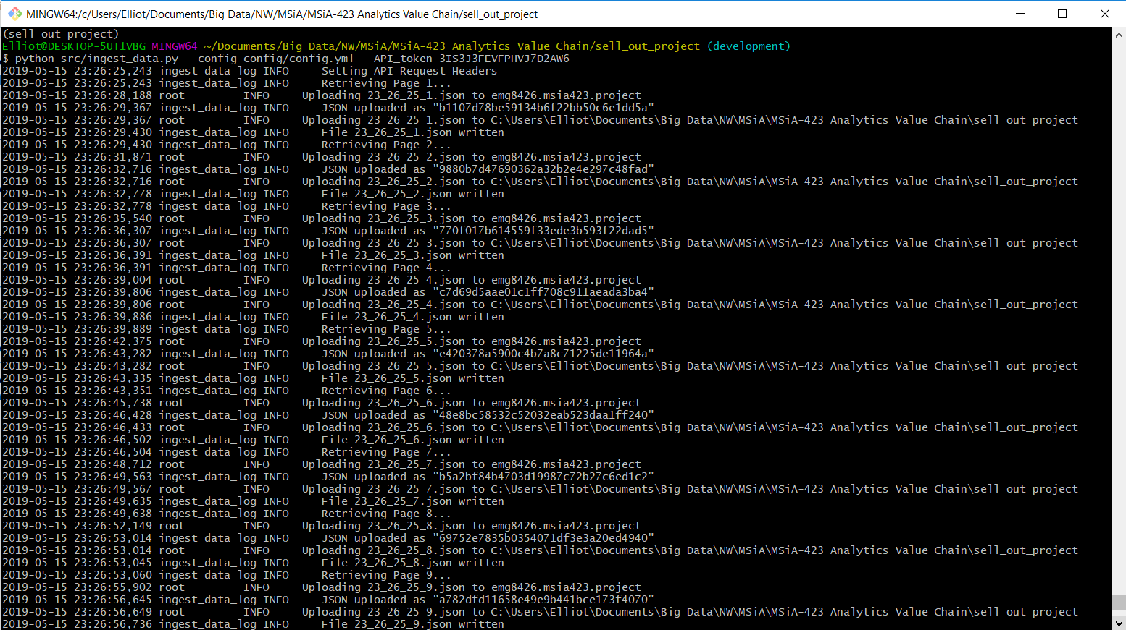
Demo

Slide 5
Lessons learned
It is better to keep all JSON files raw than to immediately ingest them into a database and lose some of the data
Connecting to RDS can be challenging to set up
Eventbrite doesn’t provide an easy way to parse the artist that will be at a music event (Spotify-incorporation would be extremely challenging)

Slide 6
Recommendations
Events Listings and Prediction - Sell-Out Prediction - Boosted Tree (1 pt)
Events Listings and Prediction - Sell-Out Prediction - Random Forest (1 pt)
Events Listings and Prediction - Sell-Out Prediction - Model Selection (2 pts)
User Interaction - Web App Construction - Database Hosting (4 pts)
User Interaction - Web App Construction - Model Hosting (4 pts)

